Slide 1
Display Advertising is Dead
Long live Display Advertising!
Odysseas Ntotsikas
Managing Director
Notes:
1
1

Slide 2
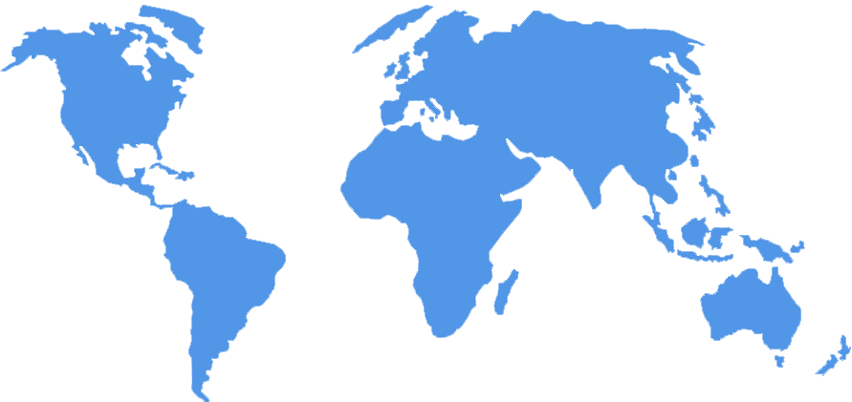
Biggest Media Network in S.E. Europe
250 M Unique Users in Europe
4m Users in RO
3,5m Users in GR
3m Users in HU 2,2m Users in BG
350k Users in CY
650 M Unique Users Worldwide

Slide 3
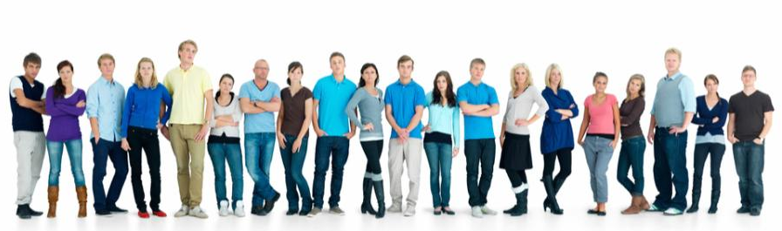
Connecting Brands with Consumers
Notes:
What we offer – reach - targeting – measurement.

Slide 4
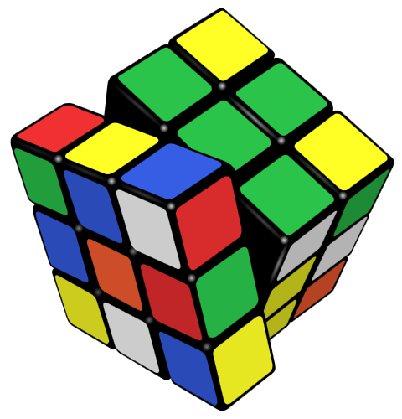
Thinkdigital
Budapest
Live: January 2011

Slide 5
Natural Born Clickers

Slide 6
Natural Born Clickers

Slide 8
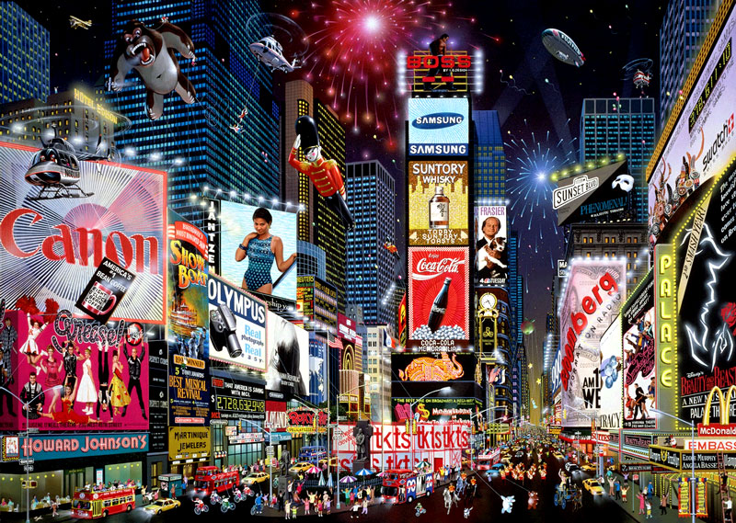
Americans see 1.800 Online Ads per Day
Forester Research 2009

Slide 9
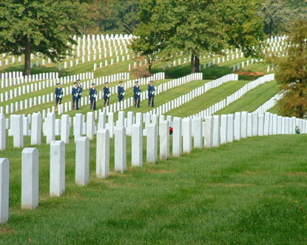
Is this the Death of
Display Advertising?

Slide 10
No.1 Seeing the Forest

Slide 11
The Purchasing Funnel

Slide 12
It is more than just Impressions & Clicks
Impression
Interaction
Post Impression Activity
Top Of Mind Awareness
Message Association
Engagement
Pre-Click Activity / Post-Interaction
Click-Thru
Post-Click Activity (Conscious Acknowledgement)
Brand
Favorability
?
Action
Required Response (Conscious Decision)
Purchase Intent

Slide 14
Display Advertising Uplifts CPG Offline Sales

Slide 15
Works even better for Online Retailers
Top Greek Online Retailer H2 2010
Sample Data

Slide 16
No.2 Using Display at its best

Slide 18
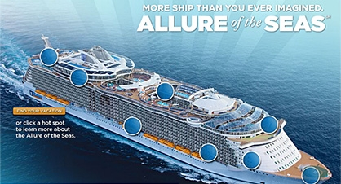
a) Involve me and I will understand

Slide 19
Rich Media & Video Work

Slide 21
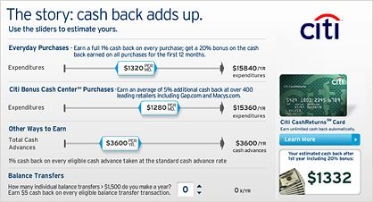
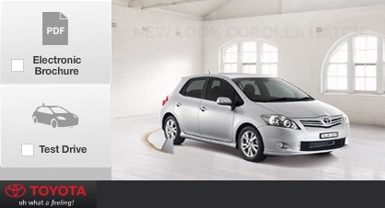
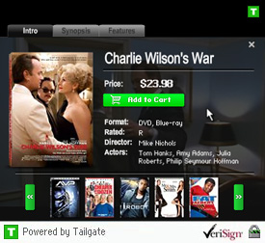
b) Finding the Shortcut
Calculate your own product
Book a Test Drive
Buy the Product from the Ad

Slide 22
Finding the shortcut

Slide 23
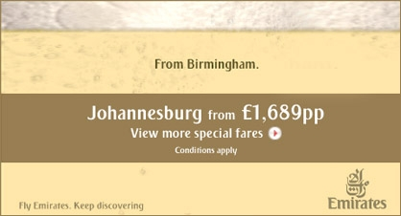
c) Do it more efficiently

Slide 24
c) Do it more efficiently
w/o Smart Versioning
w/ Smart Versioning
€3,500 production costs for master ad
€3,500 production costs for master ad
+
+
€1500 production costs per version
€0 production costs per version
x
x
30 number of versions
30 number of versions
= €48,500
= €3,500

Slide 25
No.3 Advanced Targeting

Slide 26
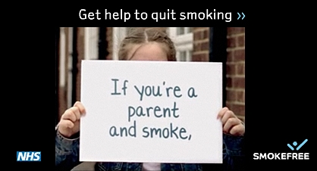
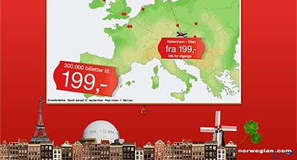
Advanced Targeting
Behavioral Sequencing
Behavioral Targeting
Re-Targeting

Slide 27
No.4 Socializing Display

Slide 28
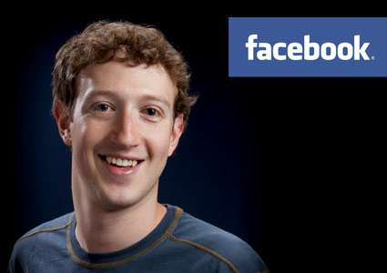
The savior of
display advertising?

Slide 29
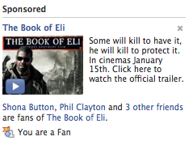
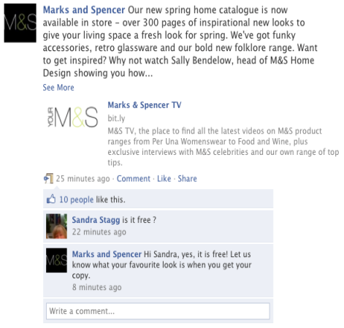
Bought to Earned Media
BRAND
Bought Media
Earned Media
Owned Media

Slide 30
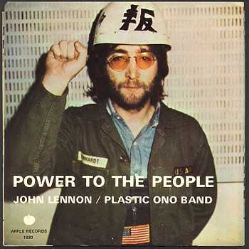
Word of Mouth scores74% as the main influence when people are asked what affects their shopping behavior.
TV’s average is less than 13%

Slide 31
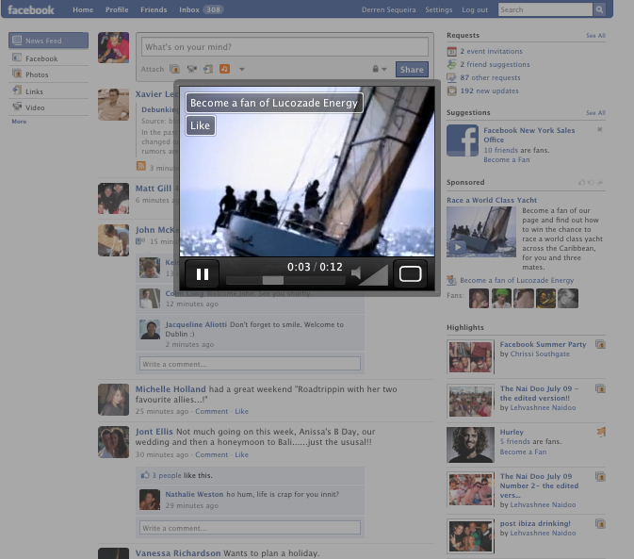
Engagement Ads
Reach Block
Become the primary advertiser over 24 hours on Facebook’s Homepage
and start getting from paid to earned media

Slide 32
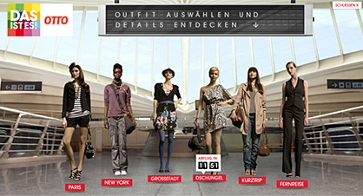
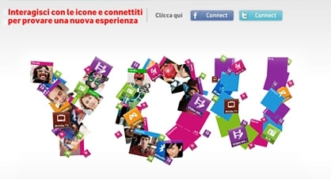
Ads Speak Social
Spread the Message!
Like/Share/Retweet
Facebook Connect

Slide 33
No.5 Bridging the Silos

Slide 35
Getting the whole picture

Slide 36
Display Influences Click Response

Slide 37
So Much Better Together

Slide 38
So What’s Next?

Slide 39
A $50bn market by 2015

Slide 40
More complex before it gets simpler

Slide 42
Contact:
Odysseas Ntotsikas
email: odyssean@thinkdigital.gr
tel: +30 210 80 26 050

